Slide 1
Virtual Concierge
https://github.com/BrassM0nkeyy/virtual-concierge

Slide 2

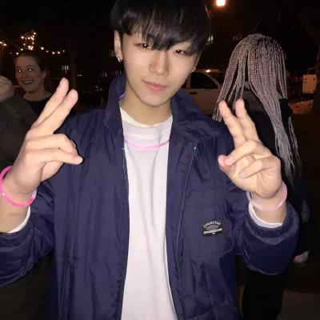



About Us
https://www.linkedin.com/in/shengxu-quan1/
https://www.linkedin.com/in/matthew-grech-6b6a56162/

Slide 3
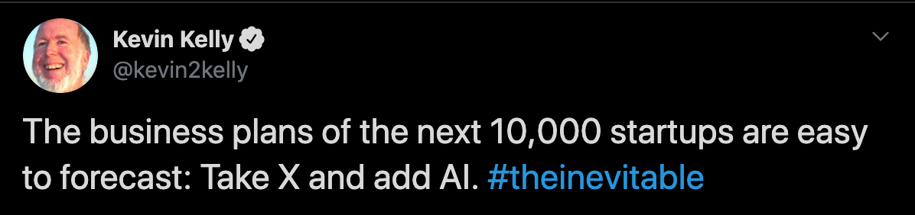
Making things smart

Slide 4
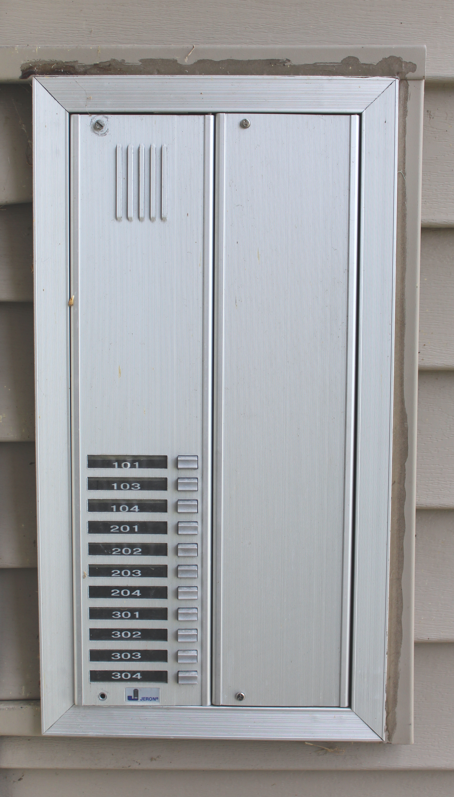
Our Problem

Slide 5

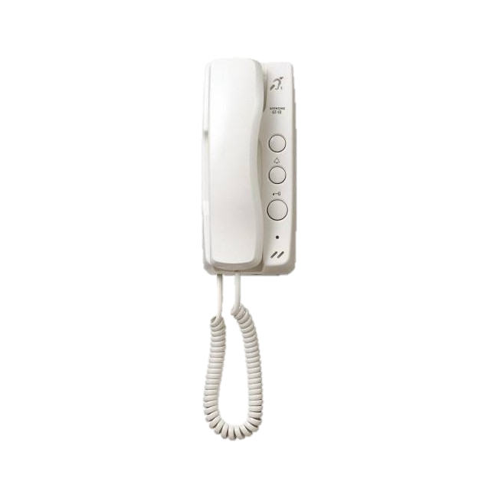

Slide 10
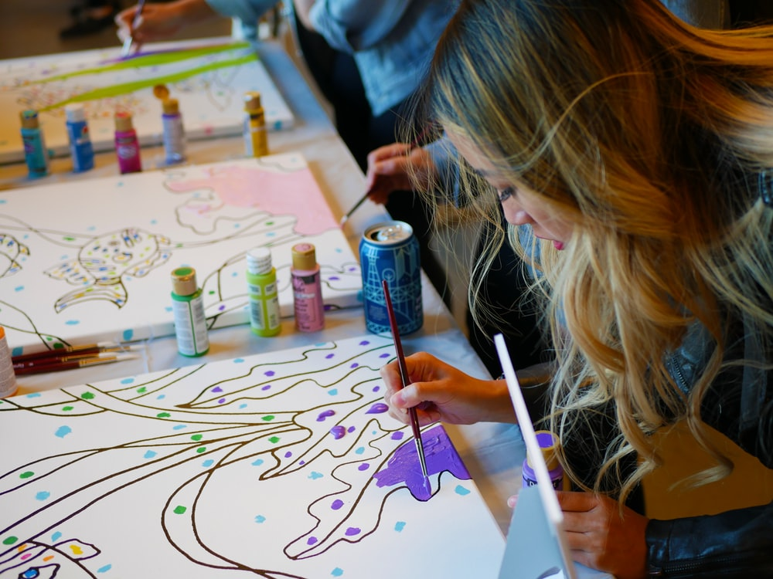
Uses
Similar implementation is being used for a local art school by our office

Slide 11
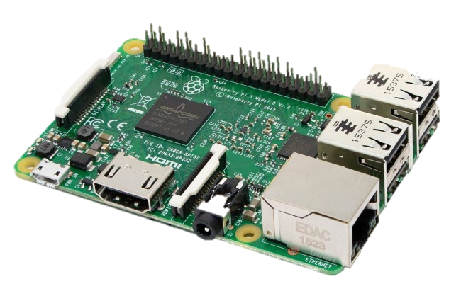

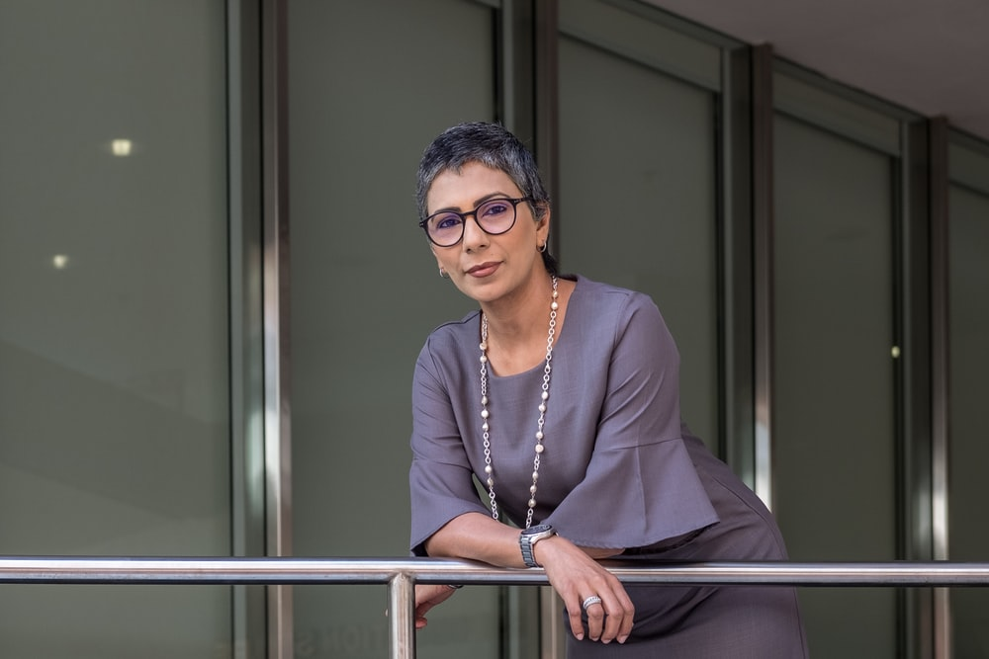


Demo Implementation
DEMO

Slide 12



Limitations

Slide 13

Get Creative

Slide 14

Does Anyone Have Experience?

Slide 15
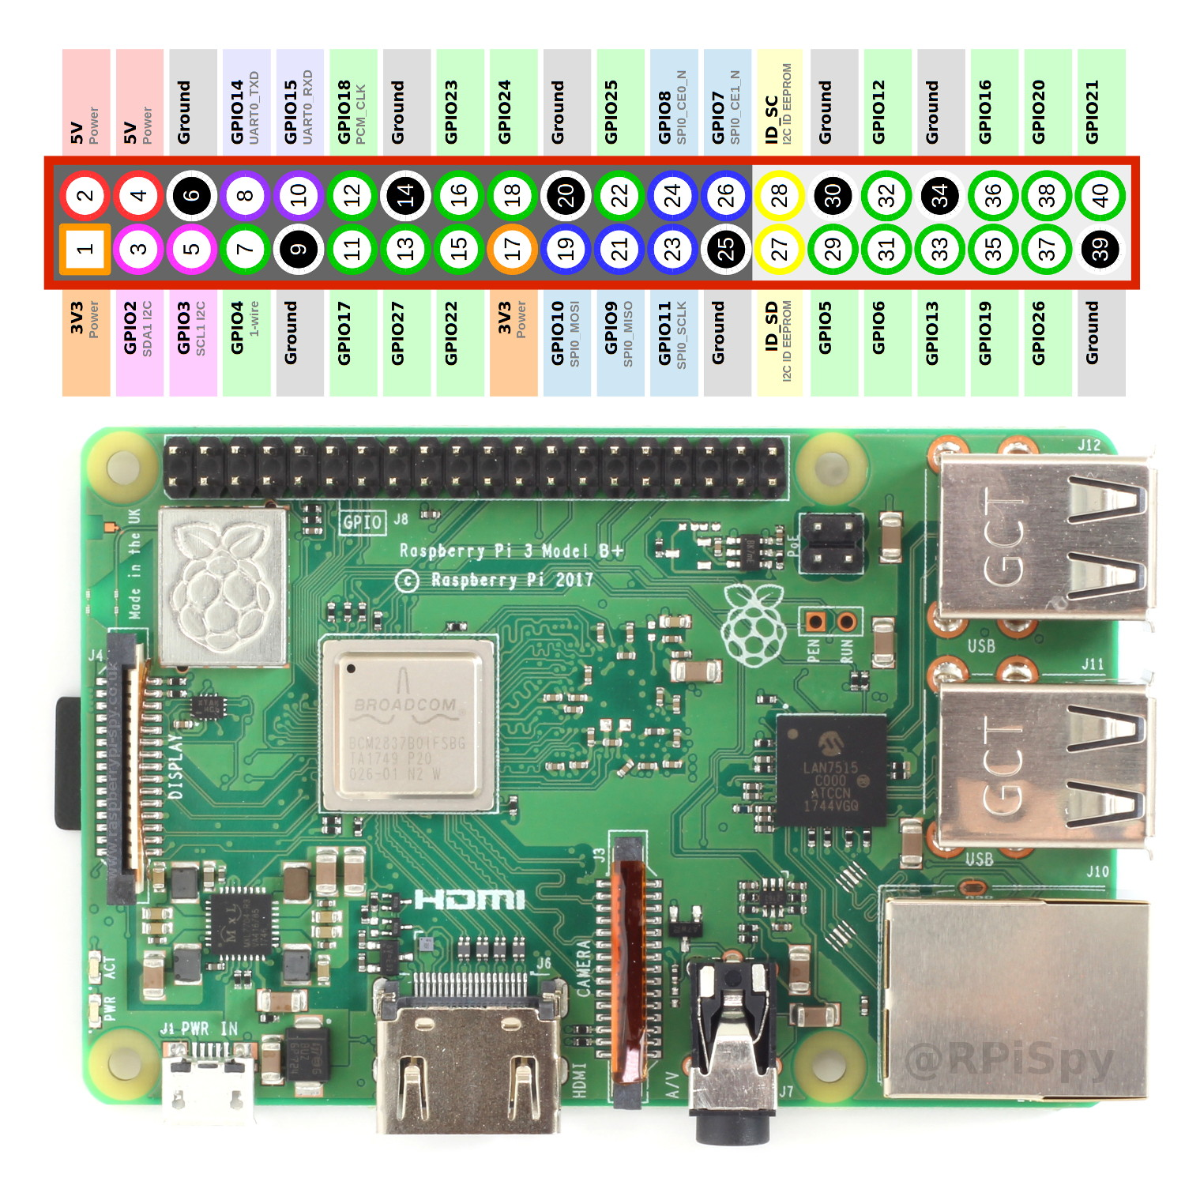

Hardware

Slide 16
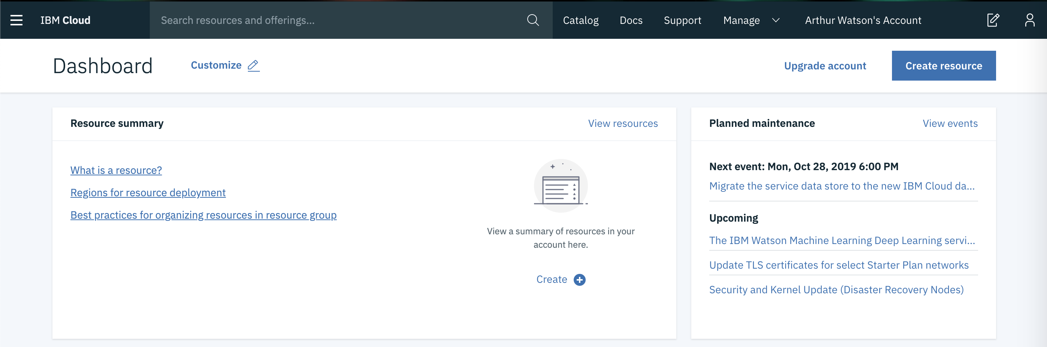
IBM Watson

Slide 17
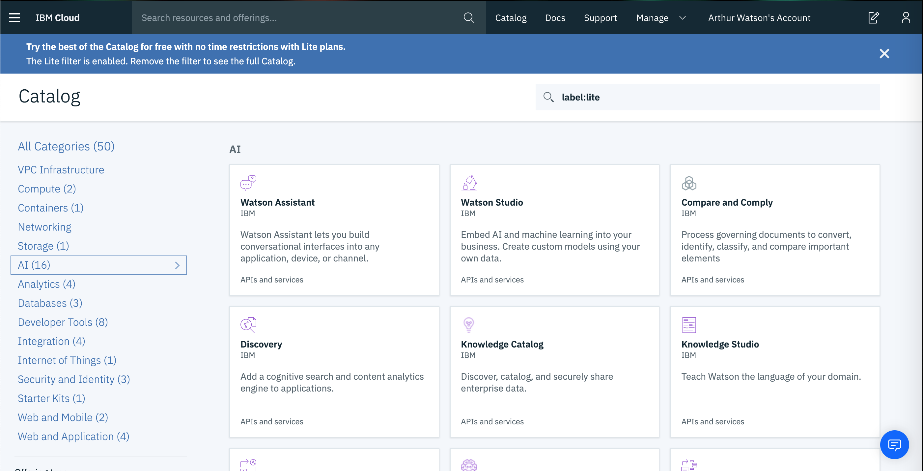

Slide 18
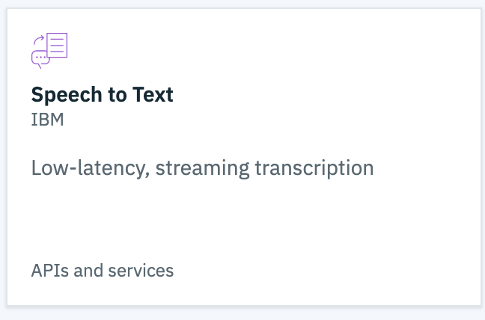
Watson Speech-to-Text
DEMO

Slide 19
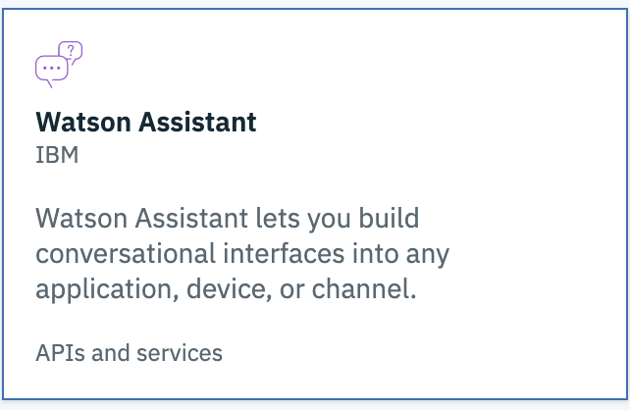
Watson Assistant
DEMO

Slide 20
Intent

Slide 21
Entity

Slide 22
Dialog

Slide 24
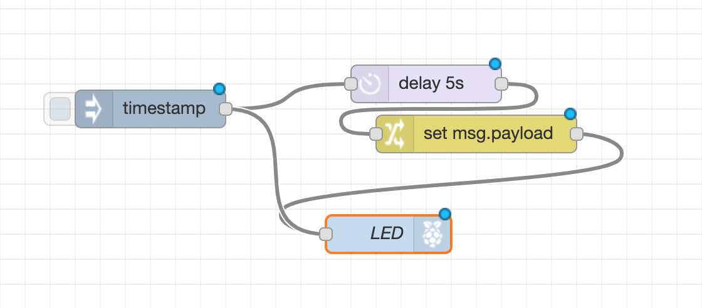
Flows

Slide 25
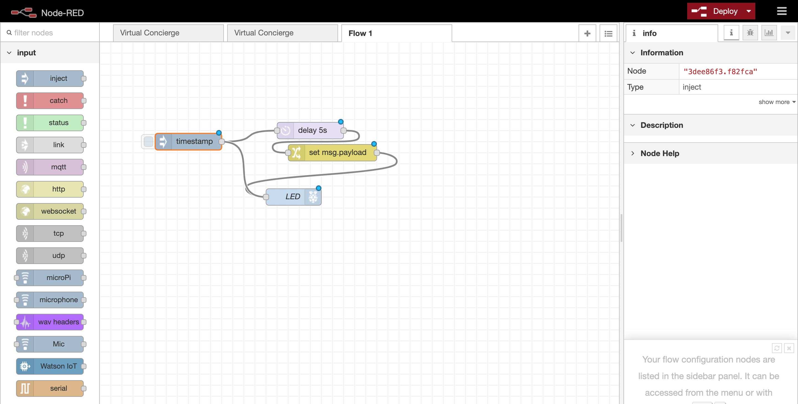

Slide 26
Side Bar

Slide 27
Info/Debugging Window

Slide 28
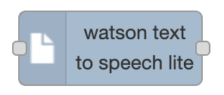
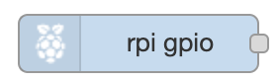
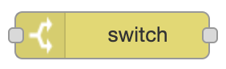
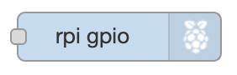
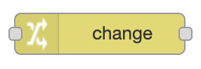

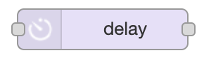
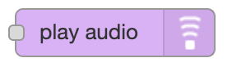
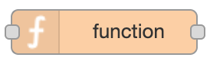

Different Nodes

Slide 29
Demo Time

Slide 30
Get Creative

Slide 31
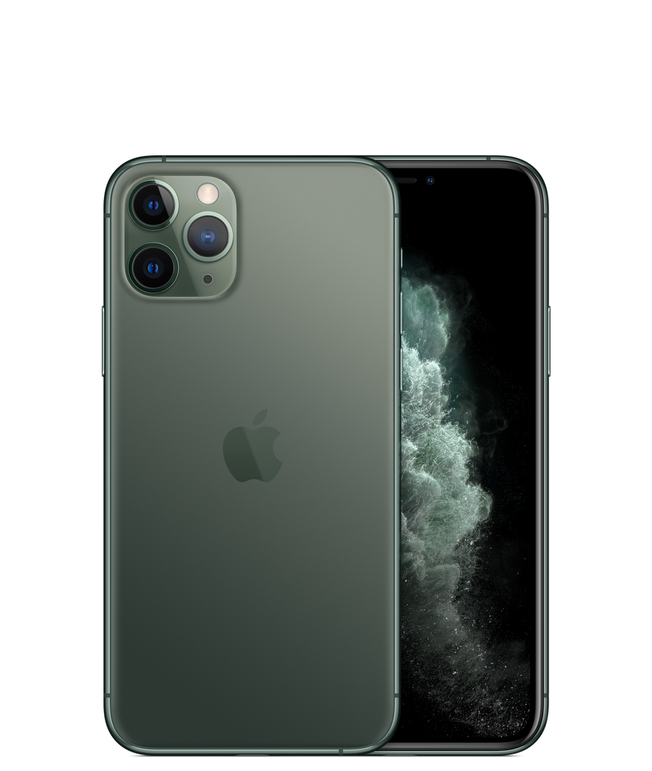


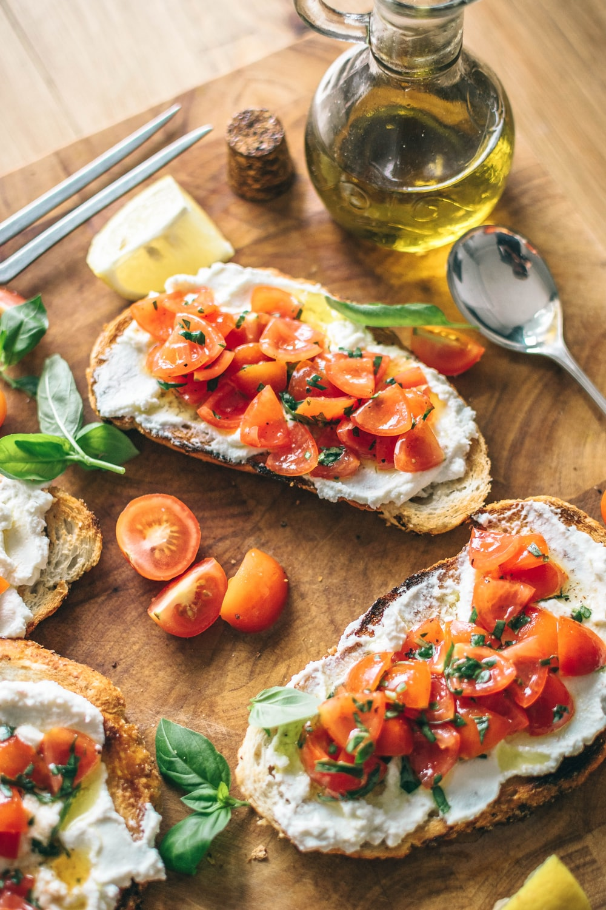
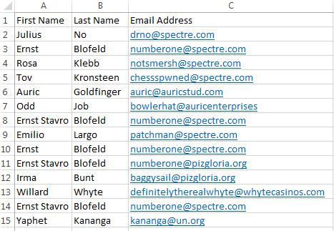
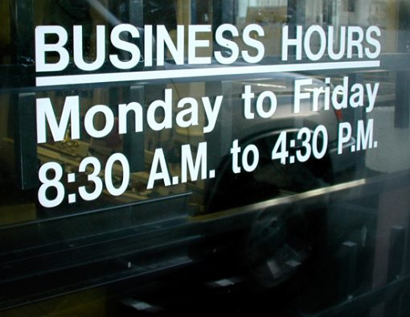
Other Ideas
Ask if open, or set a do not disturb.

Slide 32
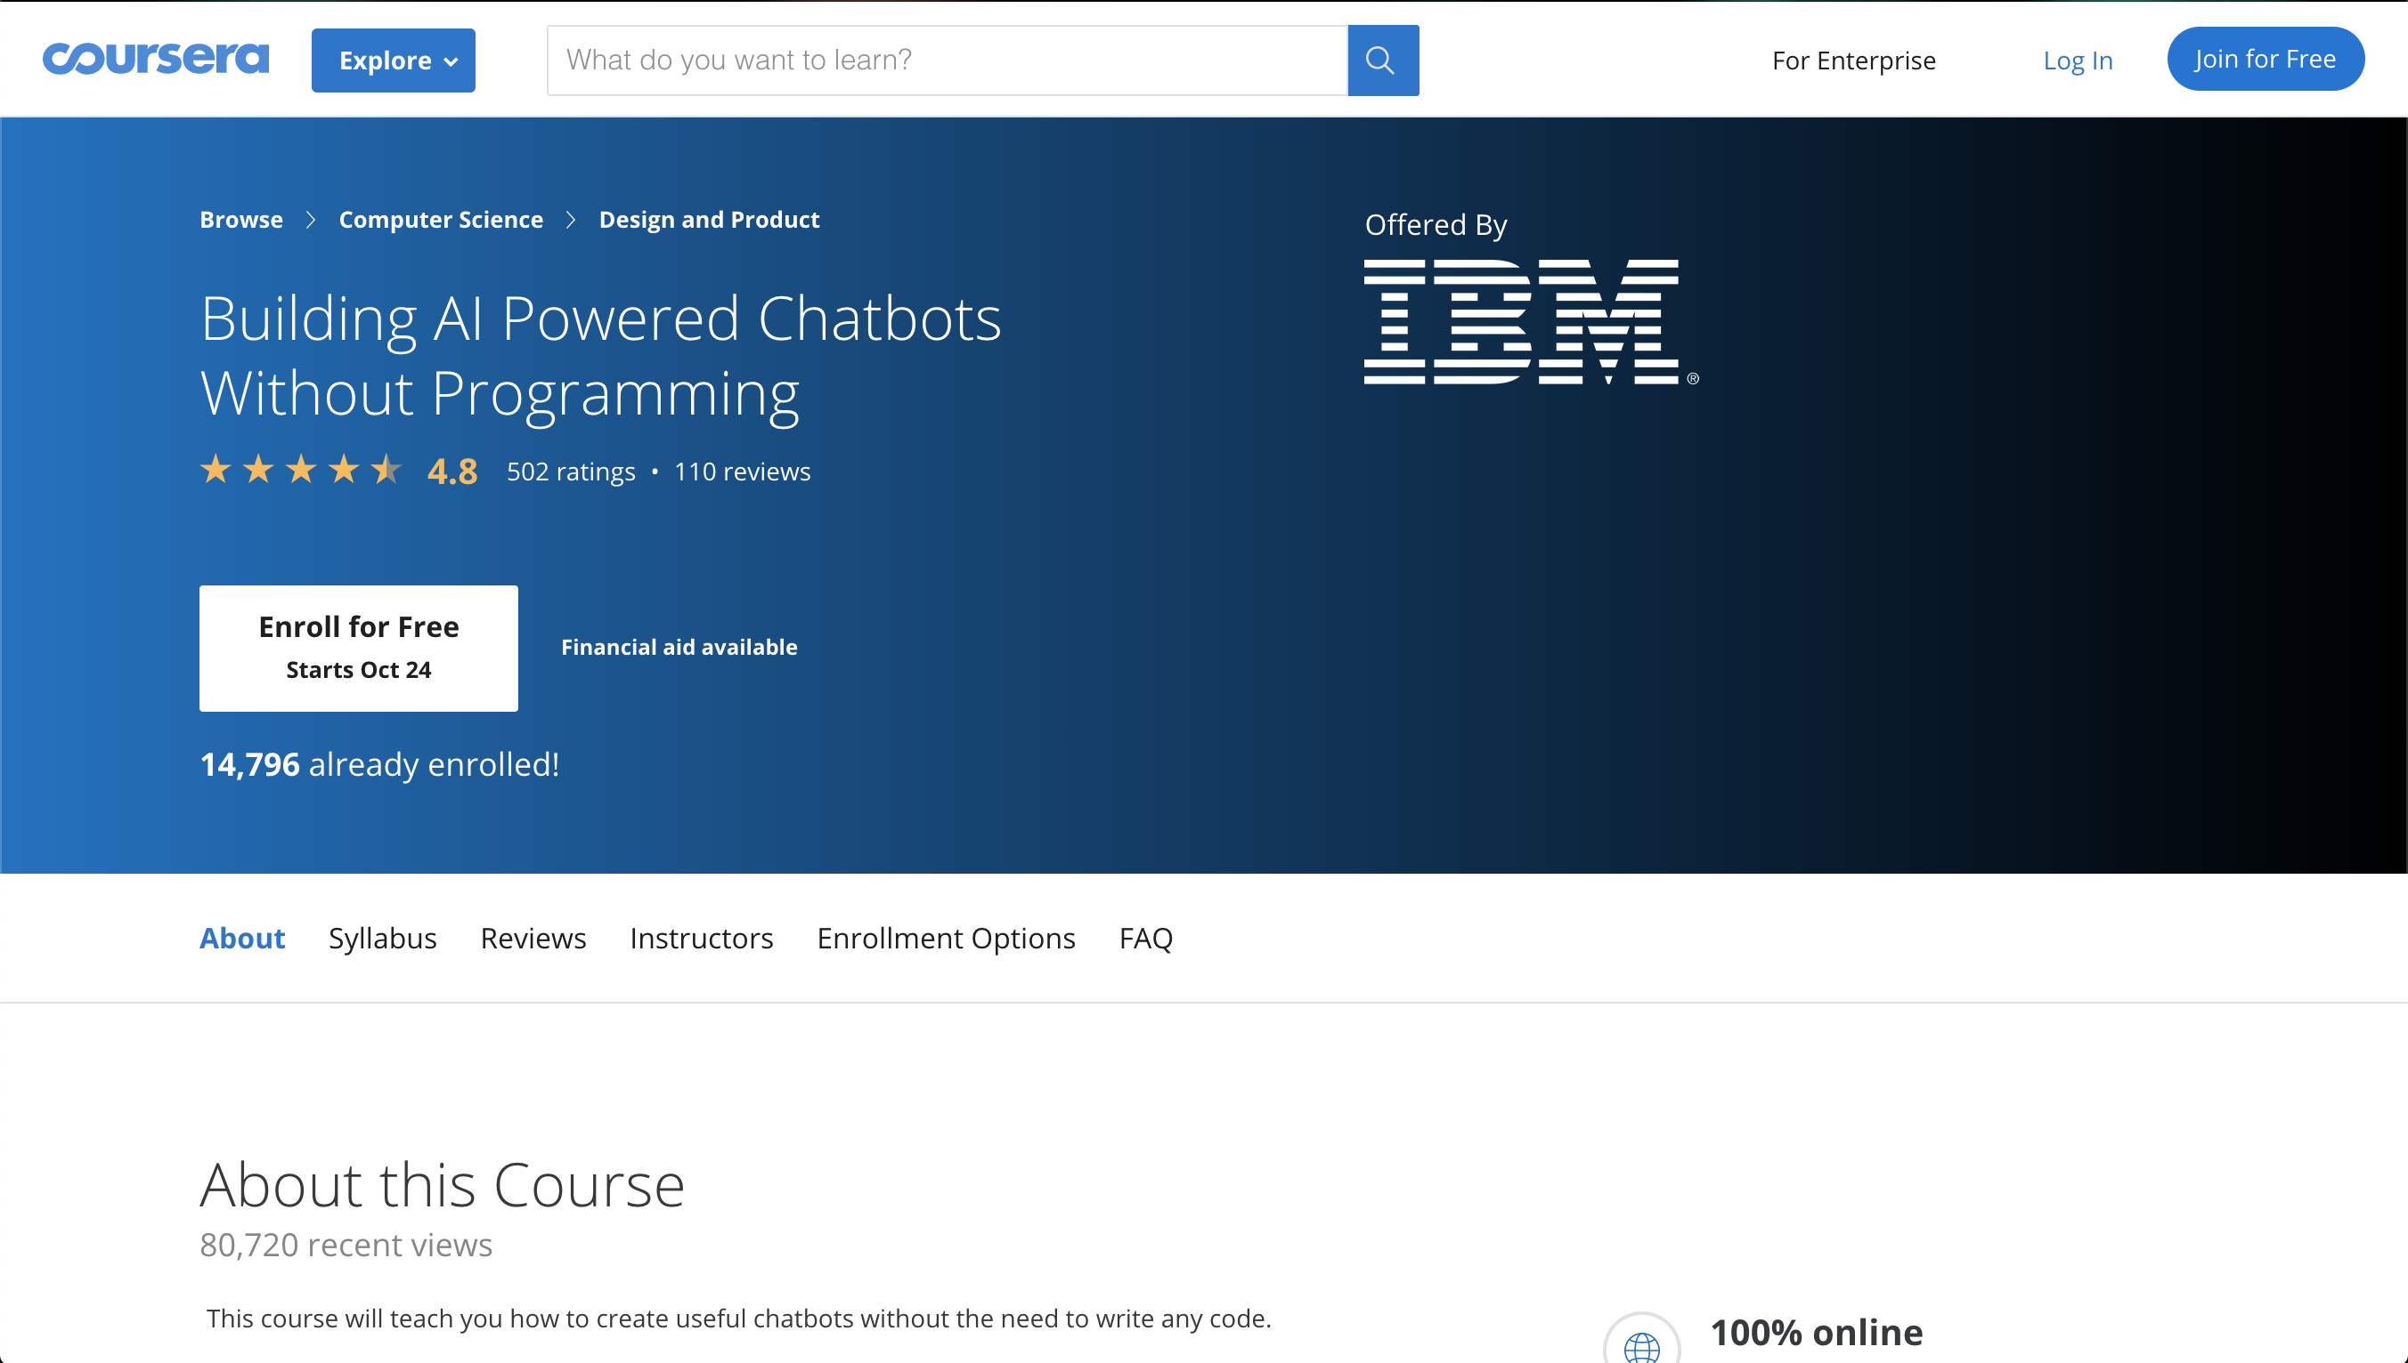

Slide 33
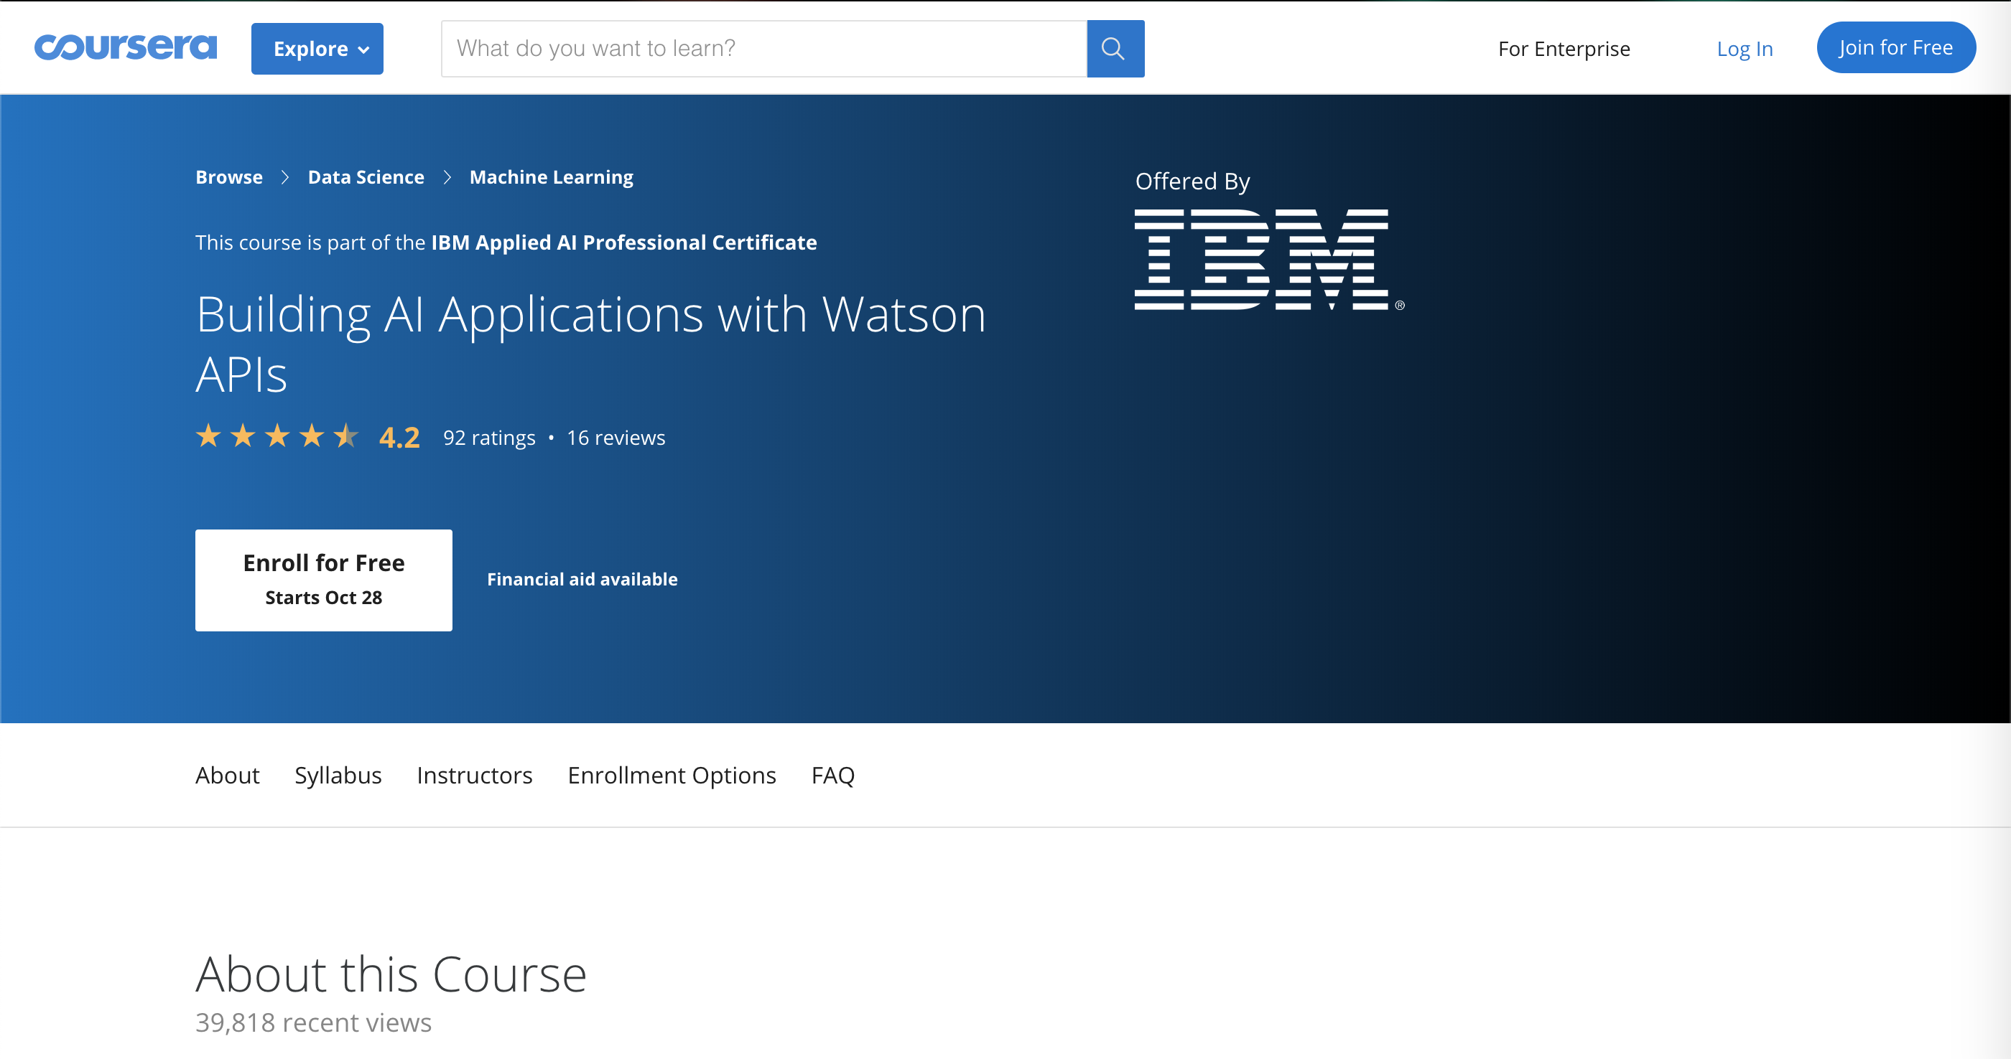
Other Resources

Slide 34


Slide 35
Contact Us

